Slide 1


Slide 2
Notes:
Get data about who we are planning to extend

Slide 4
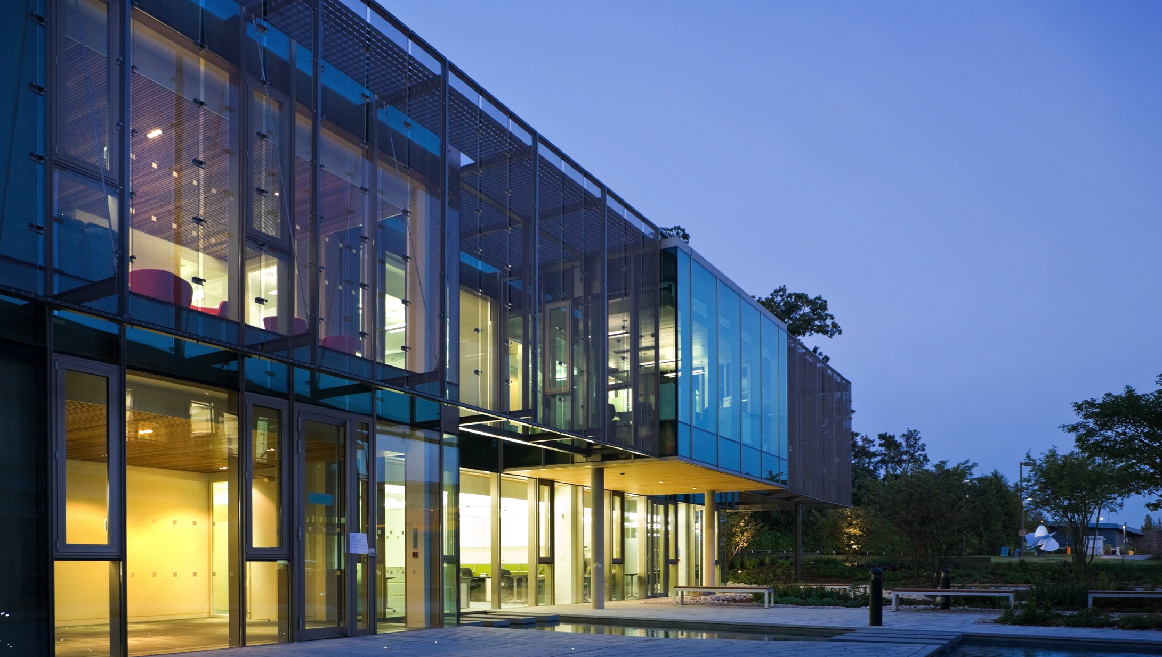
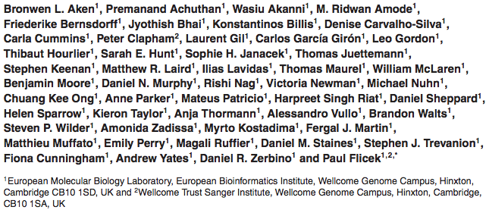








Ensembl Acknowledgements
The Entire Ensembl Team
Funding
Co-funded by the European Union

